Slide 1
Data@ANZ Virtual Experience Program
Exploratory Data Analysis
Gifty Cheruvallimalayil
gifty.reji@sdbi.in

Slide 2
About data:
The dataset contains 12043 transactions from 100 unique customers/ accounts with 23 features for the analysis.
Of these features, there is 17 categorical variables and 5 numerical variables.
Dataset contains 3 months worth of transaction, transaction period 01/08/2018 to 31/10/2018. Total 92 days.
There are missing values in some of the variables (i.e. card_present_flag, bpay_biller_code, merchant_id, merchant_code, merchant_suburb, merchant_state, merchant_long_lat)

Slide 3
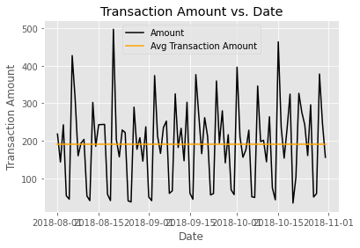
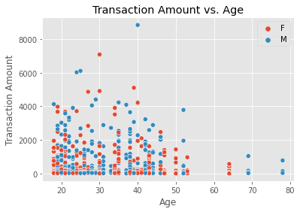
EDA - insights.
The number of average customer transactions per day is 132.34
There are some outliers in this view

Slide 4
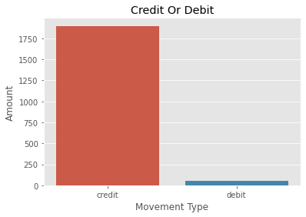
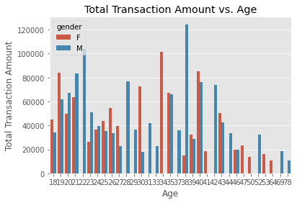
EDA - insights.
credit 1898.728029
debit 52.572343
Total Transaction Amount vs. Age

Slide 5
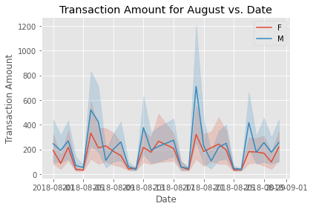
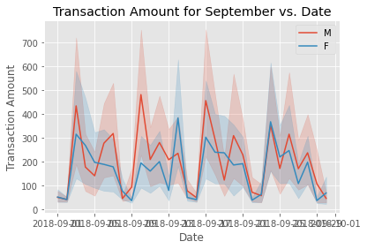
EDA - insights.
The Average Transaction amount for the month of August is - 185.12
The Average Transaction amount for the month of September is - 182.045

Slide 6
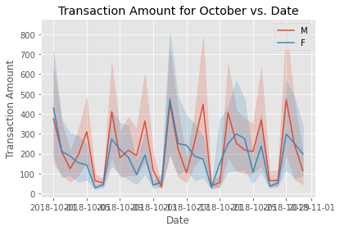
EDA - insights.
The Average Transaction amount for the month of October is - 196.427

